Slide 1

MINOR PROJECT
AUTOMATIC STREET LIGHT CONTROLLER
Name :-
Raj Yadav
Sandhya kashyap
Salma Bano
Shraddha shrivansh
Guided By :-
Mr. Mahendra Singh Thakur
Mr. Pankaj Raghuwanshi
Sem / Year :- 5th / 3rd
Branch :- Electronics and Communication

Slide 2
Content:-
Introduction
Components
Internet of Things
Circuit Diagram
Working
Advantages
Future Aspects
Proposed Design in City

Slide 3
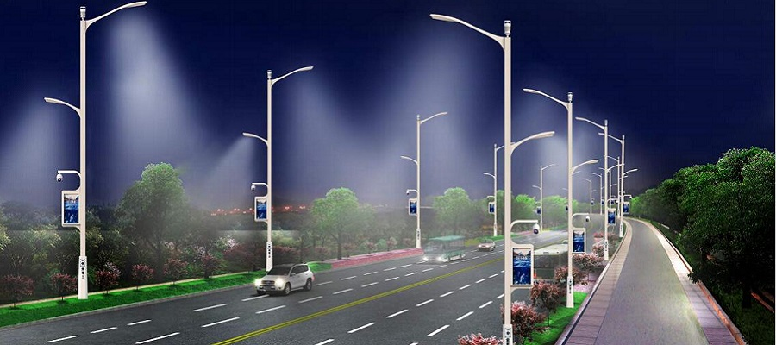
Introduction
Street lights are the major requirement in today’s life of transportation for safety. Despite that in today’s busy life no one bothers to switch it off/on when not required. The project introduced here gives solution to this by eliminating manpower and reducing power consumption.

Slide 4
Transistor
Resistor
Battery
Components
LDR Sensor
Microcontroller
LED

Slide 5
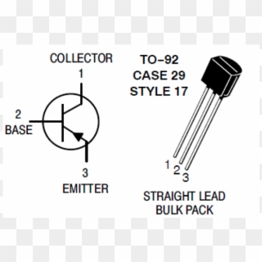
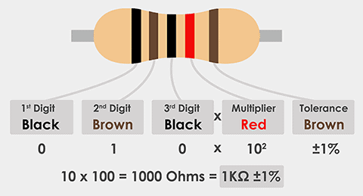
Components
Transistor :-
A transistor is a miniature semiconductor that regulates or controls current or voltage flow in addition amplifying and generating these electrical signals and acting as a switch/gate for them.
Resistor :-
A passive electrical component with two terminals that are used for either limiting or regulating the flow of electric current in electrical circuits.

Slide 6
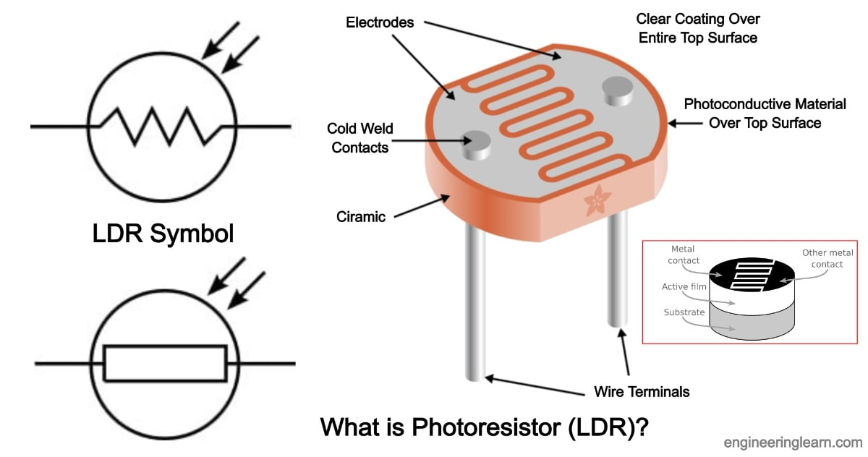
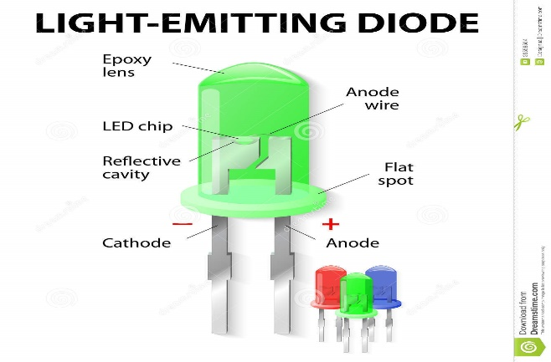
LDR Sensor :-
An LDR (Light Dependent Resistor) is a component that has a (variable) resistance that changes with the light intensity that falls upon it. This allows them to be used in light sensing circuits.
LED :-
A Light Emitting Diode (LED) is a semiconductor device, which can emit light when an electric current passes through it.

Slide 7
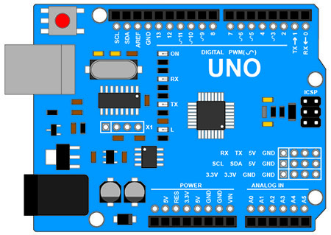
Arduino (uno) :-

Slide 8
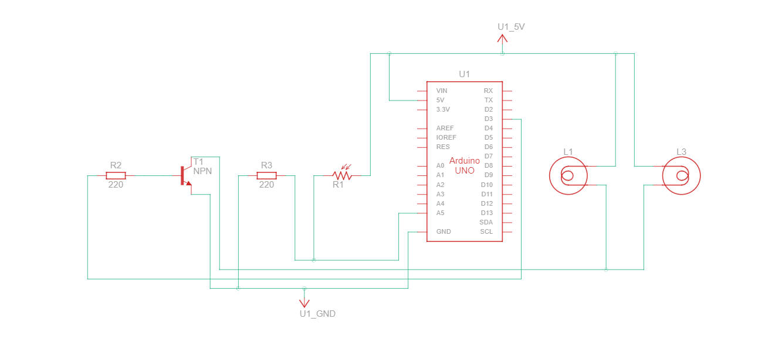
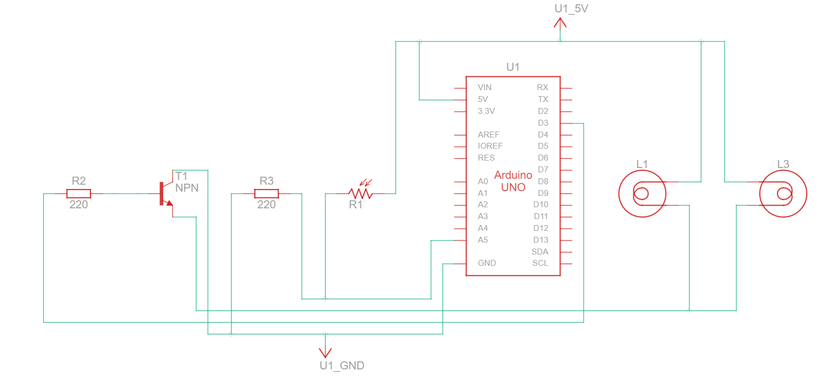
Circuit Diagram

Slide 9
Working
START
BATTERY - CURRENT PASS
LDR
IN DAY TIME
IN NIGHT TIME
SUNLIGHT FALLS RESISTANCE DECREASES , LIGHTS TO
SWITCH OFF
SUNLIGHT DON’T FALL, RESISTANCE INCREASES, LIGHT TO SWITCH ON
AUTOMATION
BY SOLID STATE RELAY

Slide 10
Advantages
Complete elimination of manpower
Reduced energy costs
Reduced green house gas emissions
Reduced maintenance costs
Higher community satisfaction

Slide 11
Future Aspects
Pole damage detection of a suitable sensor .
Taxi call buttons on lamp posts to signal to the network management centre to generate a Taxi call to the appropriate location .
Information management

Slide 12
Proposed Design in City
Bhopal the capital of Madhya Pradesh & one of the city under Smart City Project is taking steps towards smart street light system.
Installation 20000 smart lights will have following features in it .
Inbuilt astronomical timer in each luminaries which will keep lights in off condition in day time .
Individual as well as group controlling of light through CCMS ( Centralized control monitoring system ) .
Improved LUX level as per NLC.
Energy saving by reducing wattage of luminarie as compare to existing conventional lighting.
Each and every luminarie will be live on dashboard which will enable us to track the live status of luminaries .

